Slide 1

MISSION: MARSOPS_2036
WELCOME TO MARS. PLEASE DON’T DIE!
MARSOPS: DISTRIBUTED AUTOMATION PLATFORM
INSTITUTION
PROGRAM
GROUP
Sapienza University of Rome
MSc in Engineering in Computer Science & AI
LoAP

Slide 2




MARSOPS // PROJECT // V1.0
PROJECT SCOPE
MarsOps is a distributed automation platform designed to guarantee the survival of occupants in a Martian habitat by integrating
heterogeneous IoT devices into a unified monitoring system. The platform acts as a bridge between a fragile habitat's infrastructure
and the human operators.
Operators can monitor critical environmental parameters in real-time through a centralized dashboard. They can, also, define
rules to ensure that habitat actuators respond instantly to dangerous environmental shifts without manual intervention.
By evaluating sensor data against operator-defined criteria, it triggers autonomous responses, such as activating cooling
systems or emergency ventilation, without requiring manual intervention, mitigating risks in high-latency Martian environments.

Slide 3




MARSOPS // MISSION_STATUS // COMPLETE
MISSION STATUS: OPERATIONAL
RELIABILITY
AUTOMATION
SCALABILITY
Distributed architecture ensuring habitat survival through redundancy.
Smart control loops mitigating risks in high-latency environments.
Microservices-ready design for future habitat expansions.
END OF TRANSMISSION

Slide 4






MARSOPS // ARCHITECTURE // V1.0
SYSTEM ARCHITECTURE
MICROSERVICE ARCHITECTURE
AMQ AS MESSAGE BROKER
REDIS IN-MEMORY STATE CACHE
REAL-TIME WEBSOCKET DASHBOARD
DOCKER COMPOSE DEPLOYMENT
REACTIVE RULE EVALUATION

Slide 5
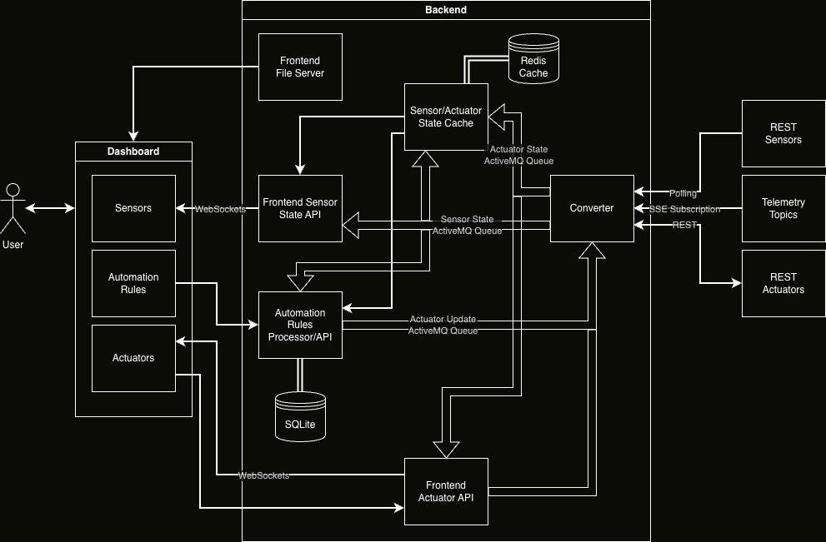
MARSOPS // ARCHITECTURE // V1.0
SYSTEM ARCHITECTURE

Slide 6




MARSOPS // CONVERTER // ARCHITECTURE
INTERNAL ARCHITECTURE
REST POLLER
WEBSOCKET
Polls 8 REST sensors every 5 seconds via httpx. Handles greenhouse_temperature, hydroponic_ph, co2_hall, air_quality, water_tank_level and more.
Subscribes to real-time telemetry streams (e.g., power, environment, thermal, airlock) with auto-reconnect on disconnect.
NORMALIZER REGISTRY
COMMAND LISTENER
Schema-driven registry: SENSOR_ID_NORMALIZERS for REST, SCHEMA_NORMALIZERS for SSE/actuators. Decouples source formats from unified schema.
AMQP receiver on actuator.commands in a dedicated daemon thread. Bridges asyncio loop and AMQP via run_coroutine_threadsafe.
STATELESS DESIGN — NO DATABASE, NO PERSISTENT STORAGE. ALL STATE LIVES IN THE BROKER.
Notes:
The internal architecture is organized into distinct layers. We have a Controller layer for handling REST endpoints related to rule management. The Repository layer manages SQLite persistence via JDBC for rules and firing history. Our Messaging layer contains JMS listeners that consume telemetry events and actuator state updates. Finally, the Rule Engine service houses the core logic for rule evaluation and command generation. This layered design ensures clear separation of responsibilities, making the system easier to maintain and test independently. This approach guarantees high reliability for our control loop. Now, let's focus on the specifics of the REST API for rule management.

Slide 7




MARSOPS // PURPOSE // REL_3.3.2
PURPOSE & CORE FUNCTIONALITY
AUTOMATED CONTROL LOOP
RULE EVALUATION
Implements the habitat's automated control loop.
Evaluates telemetry against operator-defined rules.
TELEMETRY PROCESSING
ACTUATOR COMMANDS
Continuously receives sensor telemetry from the message broker.
Emits commands for actuators when rule conditions are met.
OPERATIONAL EXAMPLE
If the temperature in a greenhouse group exceeds a configured threshold, a command is produced to switch the cooling fan ON. The process is automatic and requires no manual intervention.
Notes:
This service forms the core of our habitat's automated control loop. It continuously processes sensor telemetry from the message broker. The system evaluates this data against operator-defined rules. When a rule's conditions are met, it automatically sends a command to an actuator. For example, if he temperature in a greenhouse group exceeds a configured threshold, a command is produced to switch the cooling fan ON. The process is automatic and requires no manual intervention.

Slide 8


MARSOPS // CONVERTER-SERVICE // V1.0
CONVERTER SERVICE
The converter-service is the data ingestion and conversion layer of the MarsOps platform. It acts as a bridge between
heterogeneous IoT sources, which have different event formats and communicate in different forms (such as SSE and polling), and the event queues that the other microservices attach to, ensuring that all other components operate on homogeneous and similarly structured data.
By normalizing the way to receive data from sensors, it deduplicates the other complexity while removing it from all the
other microservices, ensuring that they can treat every source as basically identical as long as it provides the same “type” of metric (for example temperature, pressure or air particle concentration).
TARGET USER STORIES
1, 2, 3, 4, 5, 20

Slide 9




MARSOPS // CONVERTER // PIPELINE
NORMALIZATION PIPELINE
REST SENSORS (8 SOURCES)
TELEMETRY TOPICS (4 GROUPS)
Poll every 5s via
httpx
-->
SENSOR_ID_NORMALIZERS
-->
UnifiedEvent
SSE stream with auto-reconnect -->
SCHEMA_NORMALIZERS
-->
-->
sensor.events
(multicast)
UnifiedEvent
-->
sensor.events
(multicast)
ACTUATOR BOOT + COMMANDS
UNIFIEDEVENT SCHEMA
Fetch REST on startup + AMQP
actuator.commands
ActuatorEvent
group_id
at
metrics[]{id, type, value[]}
status
-->
-->
+
+
+
+
actuator.states
(anycast)
converter_version
. Two event types, two queues.
Both REST and SSE sources converge into the same UnifiedEvent schema, eliminating source-specific complexity for all downstream consumers.
Notes:
Expanding on our internal architecture, the REST API is crucial for managing our automation rules. We expose rule management under the '/api/rules' endpoint, supporting standard CRUD operations. Each rule is defined by parameters like 'group_id', 'metric_id', 'operator', 'compare_value', and 'unit'. We also specify the target 'actuator_id' and 'actuator_state', such as ON or OFF. Input validation is rigorously enforced using Jakarta Bean Validation, ensuring data integrity. Critically, every change to a rule generates a structured audit log entry, prefixed with '[AUTOMATION-AUDIT]'. This provides essential traceability for all configuration changes in our automated control system. Next, we'll delve into how these rules are actually evaluated and how commands are generated.

Slide 10

MARSOPS // TECH_STACK // REL_3.3.2
CONVERTER SERVICE - TECHNOLOGY STACK
PYTHON 3
HTTPX
AMQ (STOMP, PROTON)
Provides acceptable performance while being extremely fast to prototype in and having a rich ecosystem.
Enables HTTP request support in order to interface with the sensors’ and actuators HTTP APIs.
Interacts with the message queues in order to exchange messages with every other part of the system.

Slide 11




MARSOPS // SERVICE // CACHING
CACHING SERVICE
IN-MEMORY STORAGE
LOW LATENCY
The Caching Service uses Redis to store the most recent state of all sensors and actuators.
Provides sub-millisecond access to habitat telemetry for critical decision-making.
STATE SYNCHRONIZATION
DASHBOARD SUPPORT
Ensures all microservices have a consistent view of the habitat's current status.
Powers the real-time dashboard by providing the initial state on connection.
TECHNICAL NOTE
By decoupling state from the primary database, the Caching Service reduces load on persistent storage and ensures high availability of real-time data across the entire MarsOps ecosystem.
Notes:
Centralized State Management: Acts as the "Single Source of Truth" for the entire Mars habitat, maintaining the latest known state (Last Known Value) of all sensors and actuators.
High-Performance Storage: Leverages a Redis in-memory database to instantly store and retrieve incoming telemetry and actuator events with sub-millisecond latency.
Asynchronous Event Ingestion: Employs a dedicated background thread to consume AMQP messages from ActiveMQ (sensor.events and actuator.states topics) without blocking the FastAPI web server's event loop.
Stateless & Resilient Design: The service itself holds no internal state, delegating persistence entirely to Redis. In case of a restart, it seamlessly resumes updating the cache as new broker messages arrive.
RESTful API Layer: Exposes structured endpoints (/api/metrics, /api/actuators) that allow the frontend and other microservices to perform bulk data retrieval, which is essential for populating the dashboard on initial load.

Slide 12
MARSOPS // CONVERTER-SERVICE // V1.0
CACHE SERVICE
The cache service ensures that upon outages of the converter service, or whenever other microservices restart, they can
immediately query the system’s current state without waiting for update messages to appear on the internal event queue. It does so by using Redis as an in-memory “ephemeral” cache, that however can still immediately provide the needed data.
This powers several parts of the system: for example, whenever the frontend connects for live updates, an initial batch of
synthesized updates is immediately sent to notify it of the state that it should display, in order to never display an empty dashboard. Analogously, when the automation rules service starts, it can fetch the current state for all sensors and actuators so that it can know which rules to skip as they have already run.

Slide 13

MARSOPS // TECH_STACK // REL_3.3.2
CACHE SERVICE - TECHNOLOGY STACK
PYTHON 3
FASTAPI
REDIS
Provides built-in support for OpenAPI and Swagger documentation, as well as enabling fast API prototyping.
Provides the in-memory cache that powers the service.

Slide 14
MARSOPS // CONVERTER-SERVICE // V1.0
METRICS SERVICE
The metrics service acts as middleware between the backend’s internal event queues and cache and a user or frontend that
might just want to receive live updates over more standard web browser protocols. For this reason, it exposes WebSockets for both general updates, spanning all metrics, and more granular updates, for specific metric “group”, in order to avoid overloading a client with information that it doesn’t care about.
As described in the previous slides, when a WebSocket is opened it first sends to it the currently cached state. This ensures that as soon as clients request data, they receive a valid copy of it to display, while still getting live updates later.
Additionally, it enables discovery of all available metrics and their names and info by the frontend, making sure that it doesn’t have to hardcode almost anything.

Slide 15




MARSOPS // SERVICE // ACTUATOR
ACTUATOR SERVICE
FUNCTION
Acts as the "bridge" between the Automation Engine (logic provider) and the physical actuators of the Martian habitat.
SUBSCRIPTION
Listens to the dedicated command topic (multicast/ actuator.commands) on AMQ/Kafka.
VALIDATION
Ensures the command matches the JSON schema defined in the contract.
EXECUTION
Provides a REST POST request to the specific actuator endpoint (e.g.,
/api/actuators/cooling_fan
) to update its state. The new state is sent to the
Queue
actuator.commands
, managed by the Converter Service who will then update the state of the actuator with a REST call to the Simulator.
REAL-TIME STATE BROADCASTING
Exposes dedicated WebSocket channels (e.g.,
/api/actuators/ws
) to instantly push live state changes to the frontend. This ensures operators immediately
see the physical response (ON/OFF) to their manual commands or automated rules without refreshing the dashboard.
Notes:
Function: Acts as the "bridge" between the Automation Engine (logic provider) and the physical actuators of the Martian habitat.
Subscription: Listens to the dedicated command topic (multicast/ actuator.commands) on AMQ/Kafka
Validation: Ensures the command matches the JSON schema defined in the contract (ref: SCHEMA_CONTRACT.md).
Execution: Provides a REST POST request to the specific actuator endpoint (e.g., /api/actuators/cooling_fan) to update its state. The new state is sent to the Queue `actuator.commands` , managed by the Converter Service who will then update the state of the actuator with a REST call to the Simulator
Real-Time State Broadcasting: Exposes dedicated WebSocket channels (e.g., /api/actuators/ws) to instantly push live state changes to the frontend. This ensures operators immediately see the physical response (ON/OFF) to their manual commands or automated rules without refreshing the dashboard.

Slide 16
MARSOPS // CONVERTER-SERVICE // V1.0
ACTUATOR SERVICE
The actuator service also acts as middleware between the backend’s internal event queues and cache and a user or frontend,
however this time that is relative to the actuators’ state and their updates. For this reason, in addition to the discovery features and WebSockets for live state updates, it also provides POST endpoints to manually toggle actuators from the dashboard.
Like the metrics service, it also caches actuators’ state.

Slide 17


MARSOPS // COMMUNICATION // WS_V1.0
WEBSOCKETS
GLOBAL STATUS WEBSOCKET
/api/sensors/ws & /api/actuators/ws
Provides a broadcast stream of all sensor/actuator states, synchronizing the entire habitat dashboard upon connection by fetching the full dataset from the Redis cache.
TARGETED DEVICE WEBSOCKET
/api/sensors/{id}/ws & /api/actuators/{id}/ws
Dedicated low-latency channel for monitoring a specific hardware component, reducing overhead by filtering updates exclusively for the selected actuator ID.
Notes:
We implemented two WebSocket layers: global streams for full real-time dashboard synchronization and targeted streams for single sensor/actuator monitoring with lower latency and less traffic.
On connection, each client is initialized with the latest snapshot from Redis, then receives only live updates from broker-driven events to keep the UI always consistent.

Slide 18
MARSOPS // TECH_STACK // REL_3.3.2
METRICS/ACTUATOR SERVICES - TECHNOLOGY STACK
PYTHON 3
FASTAPI
AMQ (PROTON)

Slide 19
MARSOPS // CONVERTER-SERVICE // V1.0
AUTOMATION RULES SERVICE
The automation rules service maintains a core part of the system, by managing and persisting the automation rules that make
sure it correctly responds to specific situations detected by the sensors with the actuators it has available. For this reason, whenever it receives updates from the sensor state queue, it evaluates them against all the rules it has stored and decides if a rule needs to be fired. If so, it sends a message to the converter service to toggle the relevant actuator.
Internally, it uses SQLite to store automation rules, making sure that they don’t go lost even if the system goes down. Additionally, it stores metadata about when the rules were fired, and why.
For a frontend, it provides a rich API to view, edit and delete all rules, as well as consulting the aforementioned logging data it has collected; like the other services, it also provides a description of all this in a standardized OpenAPI format.

Slide 20

MARSOPS // TECH_STACK // REL_3.3.2
AUTOMATION RULES - TECHNOLOGY STACK
JAVA 21 + LOMBOK + JACKSON
SPRING BOOT 3.3.2
SQLITE (JDBC)
Industry-standard language, with libraries added specifically for boilerplate reduction.
Spring Web, JMS, and JDBC modules.
Lightweight embedded persistent storage.
Notes:
To achieve this functionality, we've built the service using a robust technology stack. We're leveraging Java 21 and Spring Boot 3.3.2, utilizing Spring Web for our REST endpoints and Spring JMS with ActiveMQ Artemis for reliable broker communication. Persistence is handled by Spring JDBC with SQLite, chosen for its lightweight nature and suitability for our small data model and simple query patterns. Lombok helps reduce boilerplate code, keeping our codebase clean. The service is containerized using a multi-stage Maven build, running on port 8080 inside the container and exposed as port 8084 on the host. This setup ensures efficiency and a minimal footprint. Next, we'll explore the internal structure of this service.

Slide 21
MARSOPS // REST_API // RULE_MGMT
REST API & RULE DEFINITION
ENDPOINT: /API/RULES
Standard CRUD semantics for comprehensive rule management: list, get by ID, create, update, enable/disable, and delete rules.
GROUP_ID & METRIC_ID
OPERATOR
Identifies metric within sensor group.
Comparison operator (e.g.,
lt
,
eq
,
gt
).
COMPARE_VALUE
UNIT
Threshold for comparison (numeric or string).
Optional unit filter for event value.
ACTUATOR_ID & ACTUATOR_STATE
ENABLED
Target actuator and boolean state.
Flag to activate/deactivate the rule.
VALIDATION & TRACEABILITY
Input validation is enforced via Jakarta Bean Validation (400 Bad Request for invalid inputs). All rule changes generate structured audit log entries prefixed with [AUTOMATION-AUDIT], ensuring critical configuration traceability.
Notes:
Expanding on our internal architecture, the REST API is crucial for managing our automation rules. We expose rule management under the '/api/rules' endpoint, supporting standard CRUD operations. Each rule is defined by parameters like 'group_id', 'metric_id', 'operator', 'compare_value', and 'unit'. We also specify the target 'actuator_id' and 'actuator_state', such as ON or OFF. Input validation is rigorously enforced using Jakarta Bean Validation, ensuring data integrity. Critically, every change to a rule generates a structured audit log entry, prefixed with '[AUTOMATION-AUDIT]'. This provides essential traceability for all configuration changes in our automated control system. Next, we'll delve into how these rules are actually evaluated and how commands are generated.

Slide 22
MARSOPS // RULE_ENGINE // ANTI_SPAM
RULE ENGINE & ANTI-SPAM LOGIC
EXECUTION PIPELINE
SMART SUPPRESSION
1
EVENT PARSING
If the actuator is already in the desired state, the command is suppressed to prevent broker flooding.
Extracting data from
MetricGroupStateEvent
.
2
RULE MATCHING
Retrieving rules by
group_id
+
metric_id
.
ActuatorStateListener maintains an in-memory ConcurrentHashMap of the current state of each actuator.
3
TYPED EVAL
Evaluation using
evaluateDouble()
or
evaluateString()
.
4
COMMAND GENERATION
Creating structured
ActuatorCommand
object.
5
PERSISTENCE
Recording firing in the
rule_firings
table.
Notes:
Now, let's look at how those rules actually get evaluated and trigger actions. This slide outlines the core execution pipeline of our rule engine, including a crucial anti-spam mechanism. The process starts with event parsing, extracting data from incoming MetricGroupStateEvents. We then match these events against enabled rules based on group and metric IDs, performing typed evaluation for accuracy. If a condition is met, we generate a structured ActuatorCommand and persist the firing event. To prevent flooding the broker with redundant commands, our ActuatorStateListener maintains an in-memory map of current actuator states. If an actuator is already in the desired state, we suppress the command, ensuring efficient and targeted delivery. This smart suppression is vital for system stability. Next, we'll look at how we ensure this data and these rules are durably stored.

Slide 23

MARSOPS // CONVERTER // MSG_SCHEMA
MESSAGE SCHEMA
SENSOR EVENT
ACTUATOR STATE
ACTUATOR COMMAND
→ sensor.events
→ actuator.states
← actuator.commands
{
"converter_version": "1.0.0",
"group_id": "air_quality",
"at": "2026-03...",
"metrics": [{
"id": "voc",
"type": "...",
"value": [{
"value": 604.48,
"unit": "ppb"
}]
}],
"status": "ok|warning"
}
{
"actuator_id": "cooling_fan",
"is_on": true,
"updated_at": "2026-03-..."
}
{
"actuator_id": "cooling_fan",
"is_on": true,
"created_at": "2026-03-..."
}
MESSAGING FLOW (END-TO-END)
Simulator REST API ↓ poll / fetch Converter Service ↓ normalize sensor.events (multicast) ↓ consume automation-rules ↓ evaluate rules actuator.commands (anycast) ↓ consume Converter Service
↓ REST call Simulator REST API ↓ publish new state actuator.states (anycast)
Notes:
Two event types, two queues: UnifiedEvent → sensor.events (multicast) | ActuatorEvent → actuator.states (anycast). Both REST and SSE sources converge into the same UnifiedEvent schema, eliminating source-specific complexity for all downstream consumers.

Slide 24
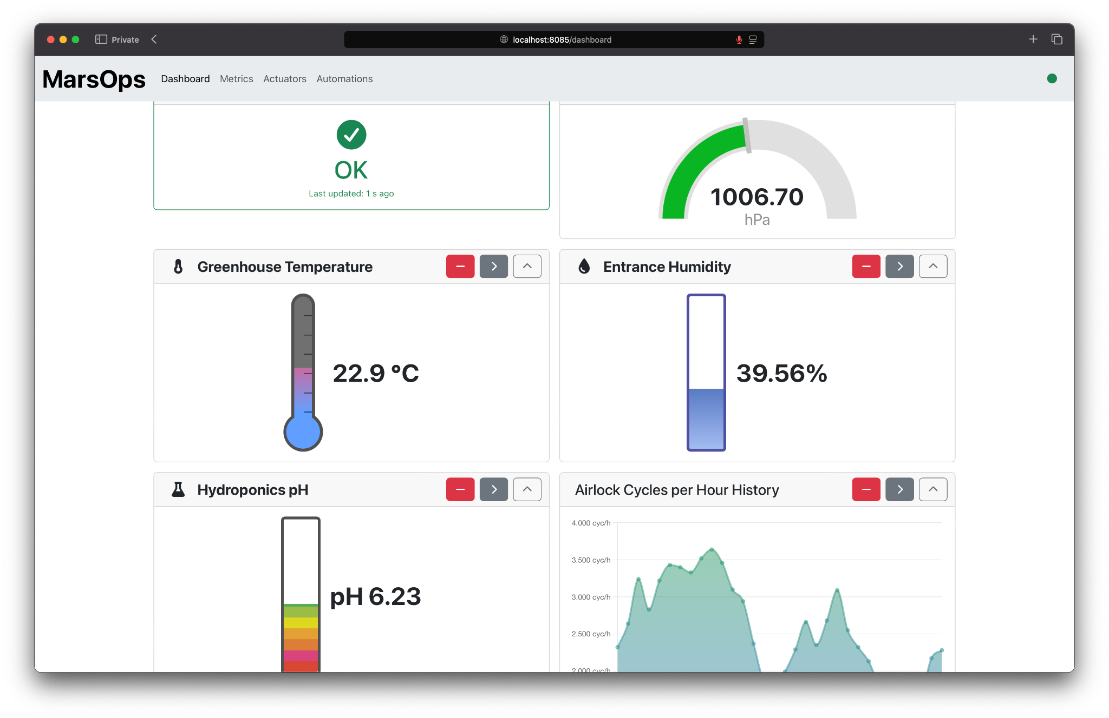
MARSOPS // CONVERTER // MSG_SCHEMA
FRONTEND

Slide 25
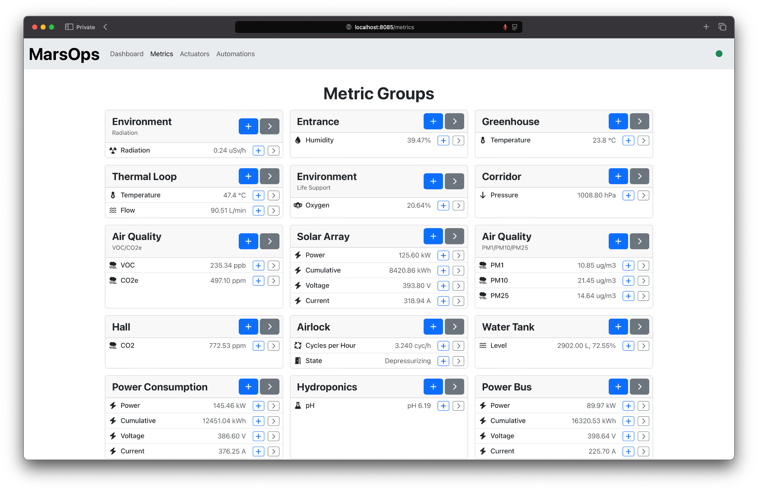
MARSOPS // CONVERTER // MSG_SCHEMA
FRONTEND

Slide 26
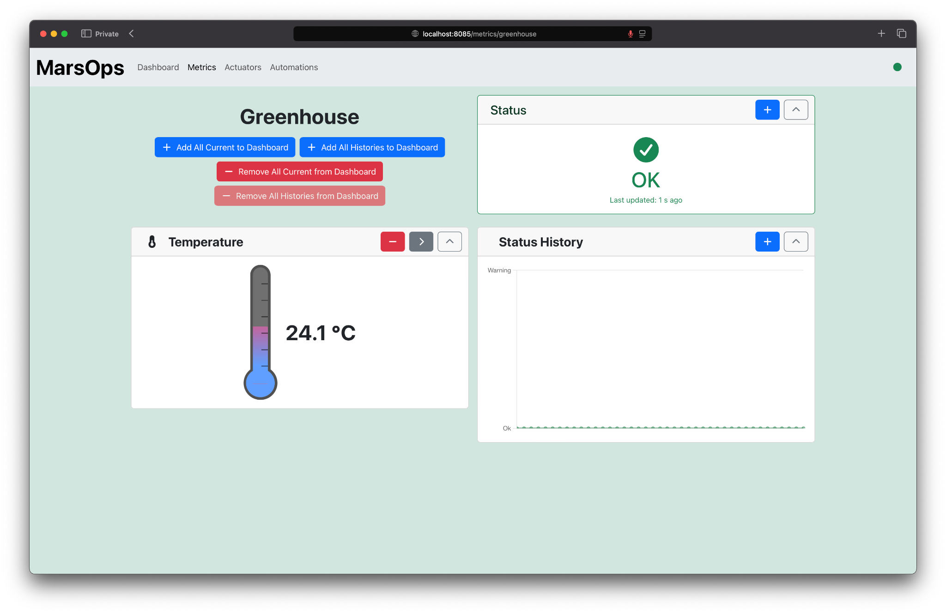
MARSOPS // CONVERTER // MSG_SCHEMA
FRONTEND

Slide 27
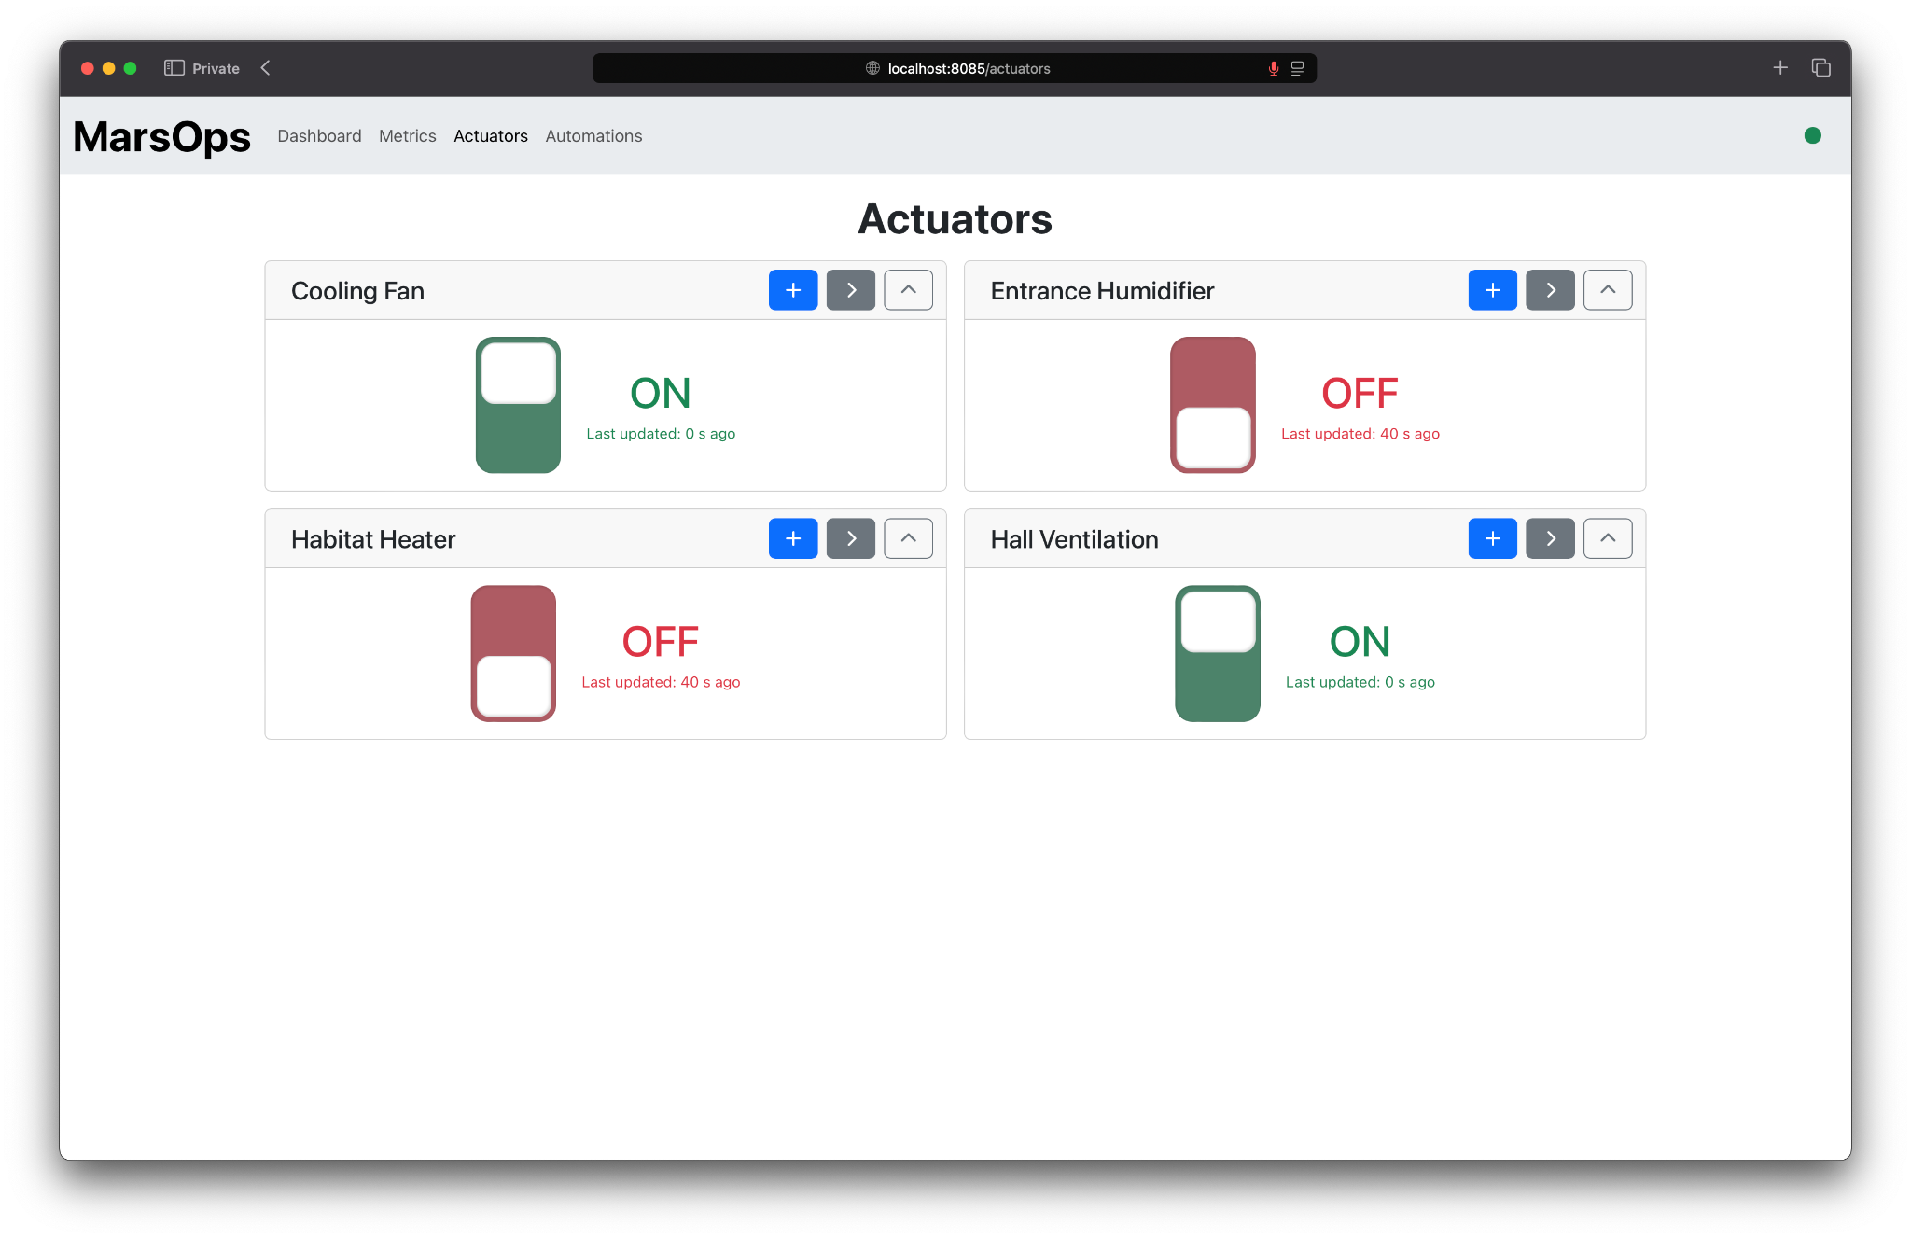
MARSOPS // CONVERTER // MSG_SCHEMA
FRONTEND

Slide 28
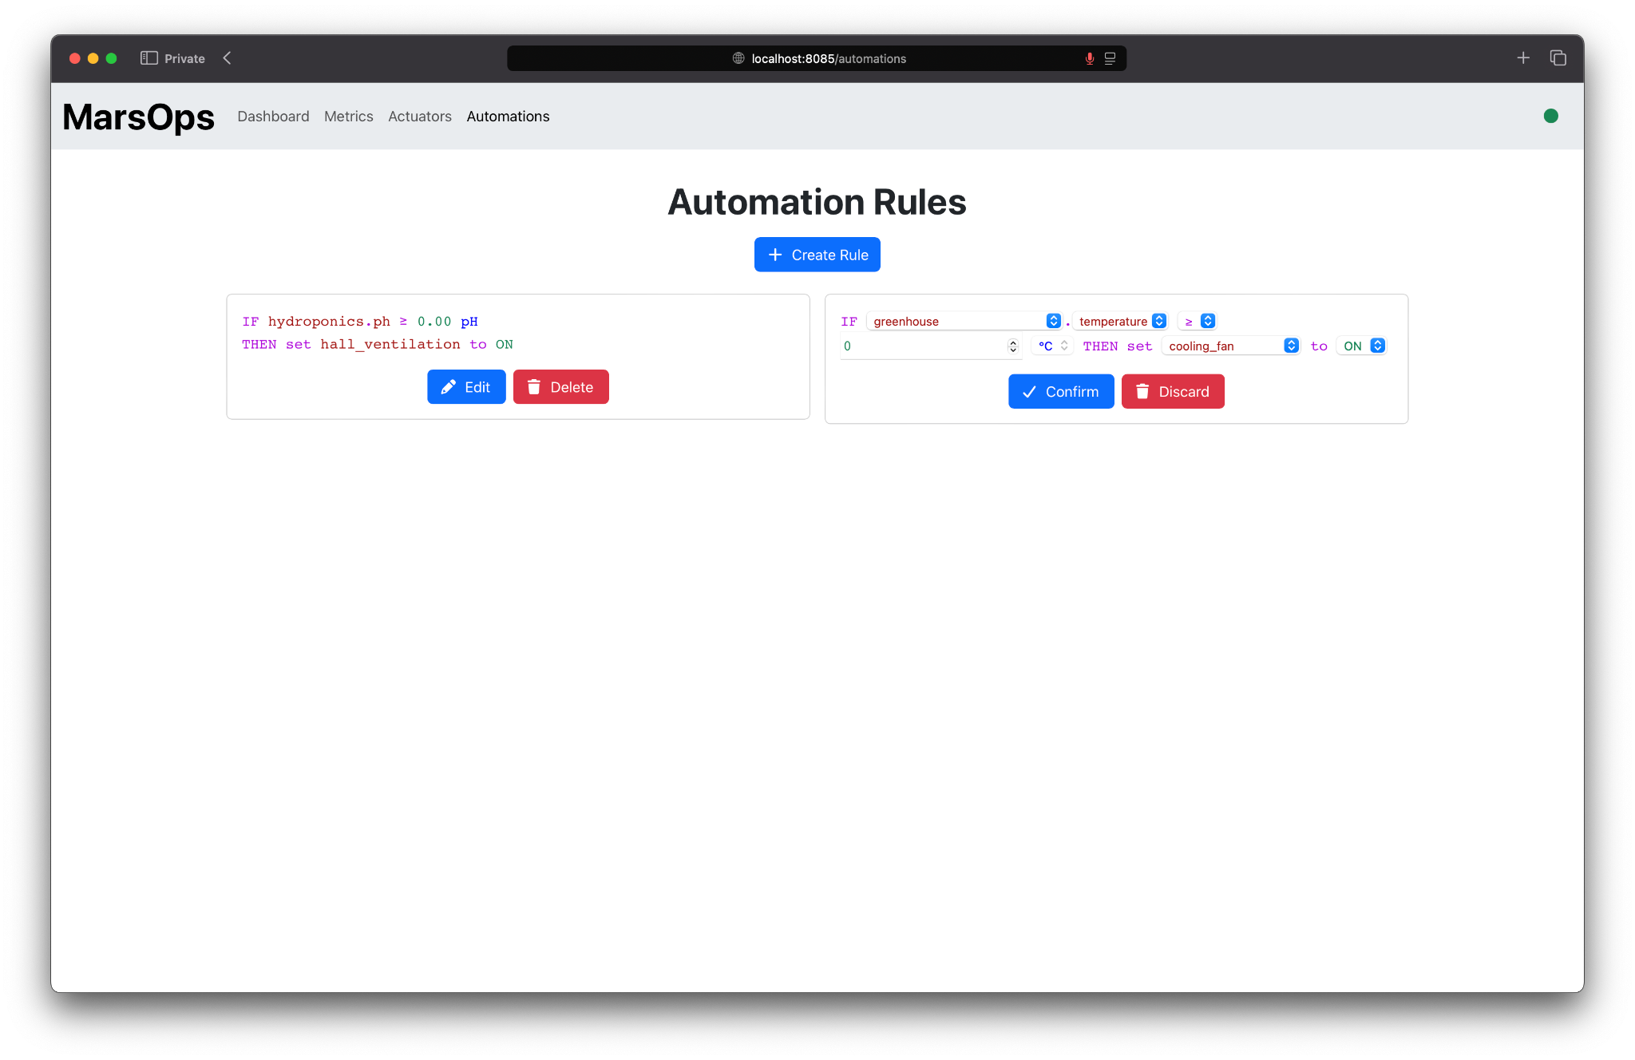
MARSOPS // CONVERTER // MSG_SCHEMA
FRONTEND

